Slide 1
Usability Heuristics
Lecture 5

Slide 2
Design principles
broad usability statements that guide a developer’s design efforts
  use the users language
  provide feedback…
derived from common design problems across many systems

Slide 3
Heuristic evaluation
Systematic inspection to see if interface complies to guidelines
Method
  3-5 inspectors
  usability engineers, end users, double experts…
  inspect interface in isolation (~1–2 hours for simple interfaces)
  compare notes afterwards
    single evaluator only catches ~35% of usability problems
    5 evaluators catch 75%
Works for paper, prototypes, and working systems

Slide 4
Heuristic evaluation
Advantages
  “minimalist” approach
    a few guidelines identify many common usability problems
    easily remembered, easily applied with modest effort
  discount usability engineering
    end users not required
    cheap and fast way to inspect a system
    can be done by usability experts, double experts, and end users
Problems:
  principles are more or less at the motherhood level
    can’t be treated as a simple checklist
    subtleties involved in their use

Slide 5
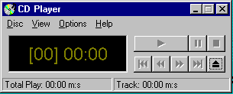
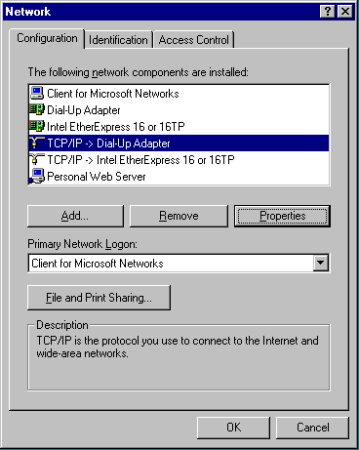
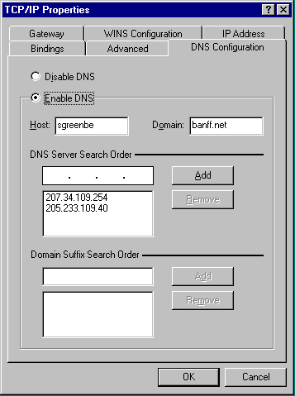
1 Simple and natural dialogue
  use the user’s conceptual model
  match the users’ task sequence
  minimize mapping between interface and task semantics
From Microsoft applications

Slide 6
1 Simple and natural dialogue
Present exactly the information the user needs
  less is more
    less to learn, to get wrong, to distract...
  information should appear in natural order
    related information is graphically clustered
    order of accessing information matches user’s expectations
  remove or hide irrelevant or rarely needed information
    competes with important information on screen
  remove modes
  use windows frugally
    don’t add unneeded navigation and window management

Slide 7
1 Simple and natural dialogue
Compuserve Information Manager
File Edit Services Mail Special Window Help
Services
Telephone Access Numbers
PHONES
Access Numbers & Logon Instructions
United States and Canada
United States and Canada
CompuServe Network
Only 9600 Baud
List
? List
List by:
State/Province
Area Code

Slide 8
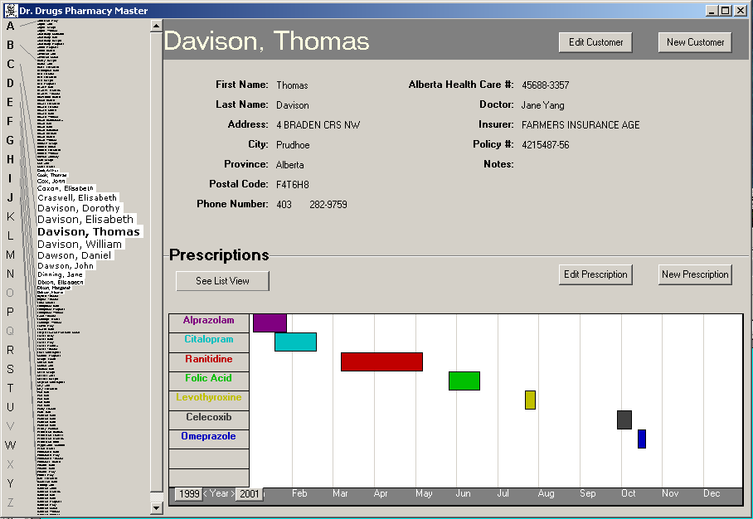
Good: information all in the same place
By previous 481 students Brant LeClercq, Lloyd Yoon, Amy Yang (with permission)

Slide 9
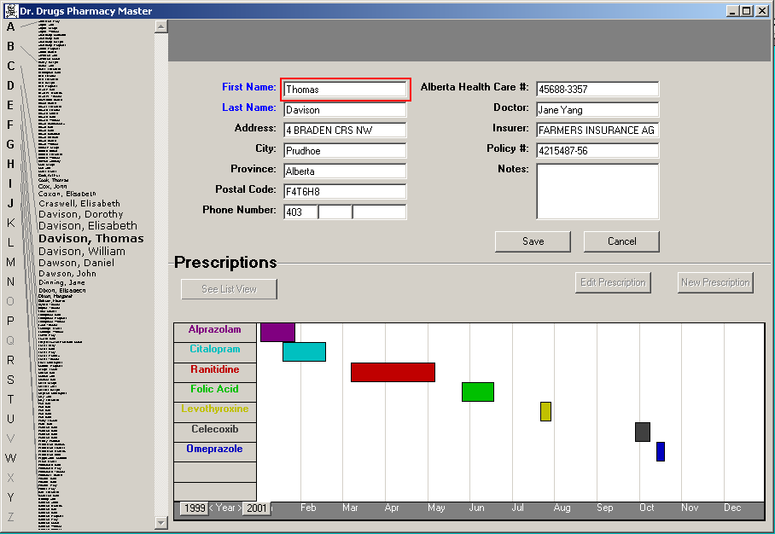
Good: information all in the same place
Bad: special edit mode
By previous 481 students Brant LeClercq, Lloyd Yoon, Amy Yang (with permission)

Slide 10
By previous 481 students Brant LeClercq, Lloyd Yoon, Amy Yang (with permission)

Slide 11
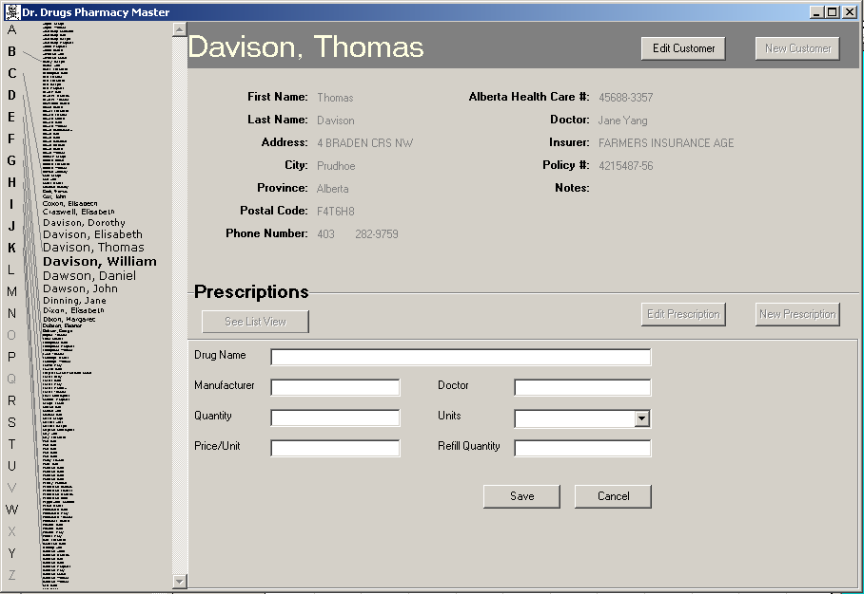
Good: Stable parts of the window
Bad: Prescriptions separate from graphics
By previous 481 students Brant LeClercq, Lloyd Yoon, Amy Yang (with permission)

Slide 12
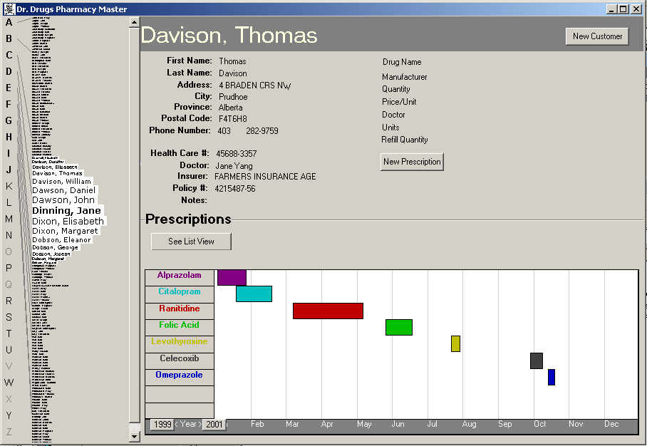
collapsed onto
one screen
(needs formatting)
Click to get info
Double click to edit
(mode buttons gone)
Add Undo
By previous 481 students Brant LeClercq, Lloyd Yoon, Amy Yang (with permission)

Slide 13
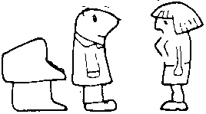
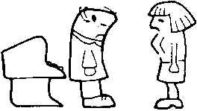

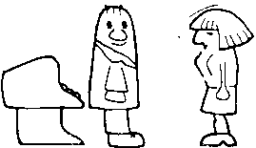
2 Speak the users’ language
My program gave me the message Rstrd Info.
What does it mean?
That’s restricted information
But surely you can tell me!!!
No, no… Rsdrd Info stands for “Restricted Information”
Hmm… but what does it mean???
It means the program is too busy to let you log on
Ok, I’ll take a coffee

Slide 14
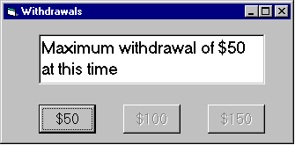
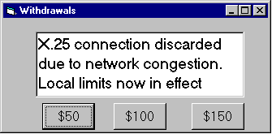

2 Speak the users’ language
Terminology based on users’ language for task
  e.g. withdrawing money from a bank machine
Use meaningful mnemonics, icons & abbreviations
  eg File / Save
    Ctrl + S (abbreviation)
    Alt FS (mnemonic for menu action)
    (tooltip icon)

Slide 15
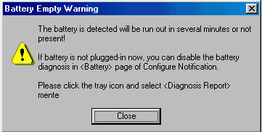
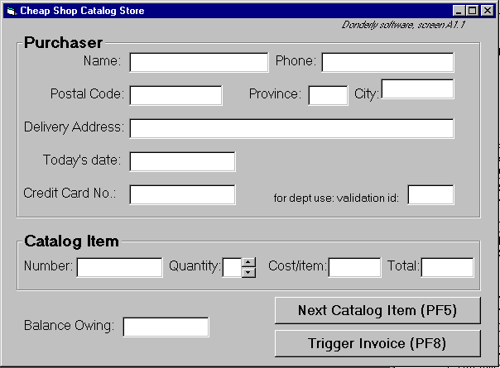
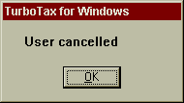
2 Speak the users’ language

Slide 16
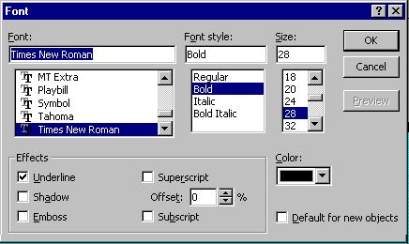
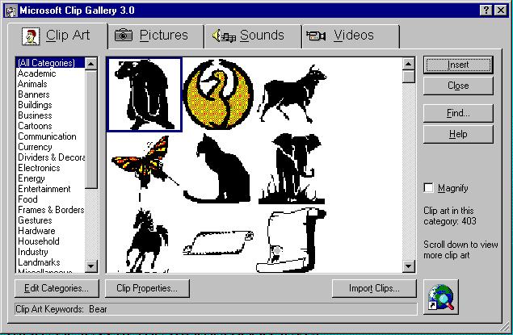
3 Minimize user’s memory load
Computers good at remembering, people are not!
Promote recognition over recall
  menus, icons, choice dialog boxes vs commands, field formats
  relies on visibility of objects to the user (but less is more!)
From Microsoft applications

Slide 17
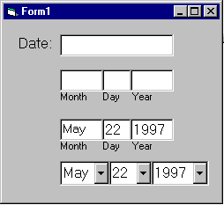
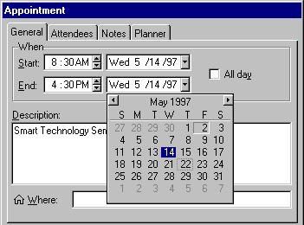
3: Minimize user’s memory load
Gives input format, example and default

Slide 18
3: Minimize user’s memory load
Small number of rules applied universally
  generic commands
    same command can be applied to all interface objects
      interpreted in context of interface object
    copy, cut, paste, drag ’n drop, ... for characters, words, paragraphs, circles, files
    context menus

Slide 19
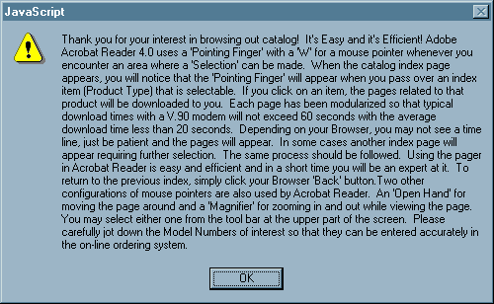
3: Minimize user’s memory load

Slide 20
4: Be consistent
Consistent syntax of input
Consist language and graphics
  same visual appearance across the system (e.g. widgets)
  same information/controls in same location on all windows
Consist effects
  commands, actions have same effect in equivalent situations
    predictability
Ok
Cancel
Cancel
Ok
Ok
Accept
Dismiss
Cancel

Slide 21
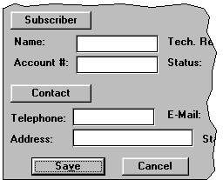
4. Be Consistent
These are labels with a raised appearance.
Is it any surprise that people try and click on them?

Slide 22
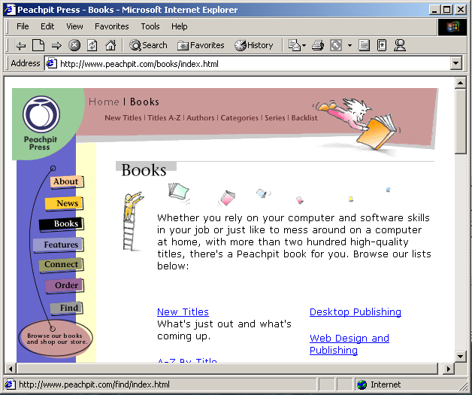
From Peachpit website

Slide 23
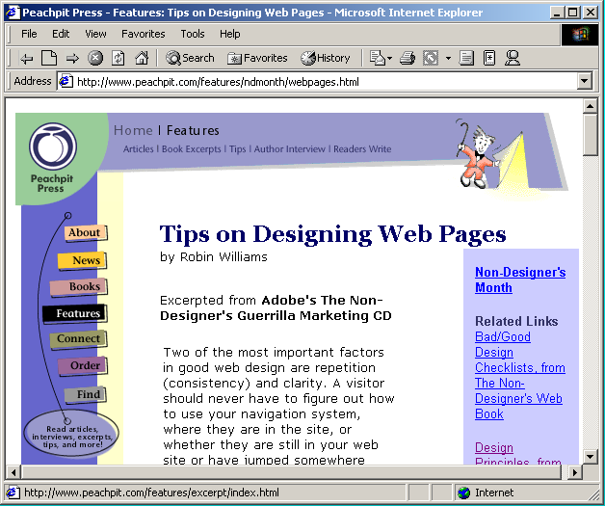
From Peachpit website

Slide 24
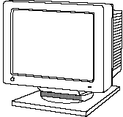


5: Provide feedback
Continuously inform the user about
  what it is doing
  how it is interpreting the user’s input
  user should always be aware of what is going on
What’s it doing?
Time for coffee.
> Doit
> Doit
This will take
5 minutes...

Slide 25
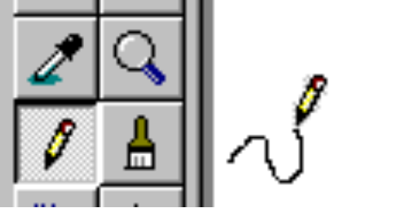
5. Provide feedback
What mode am I in now?
What did I select?
How is the system interpreting my actions?
Microsoft Paint

Slide 26
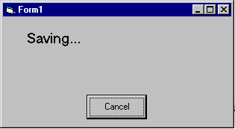
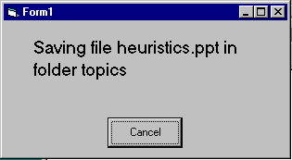
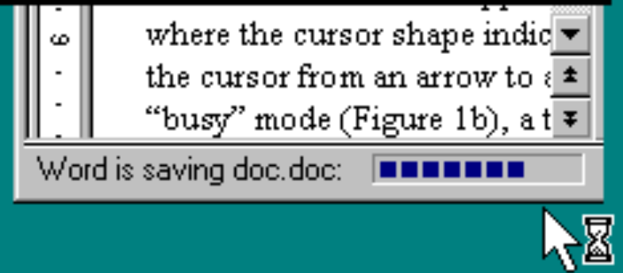
5. Provide feedback
Be as specific as possible, based on user’s input
Best within the context of the action

Slide 27
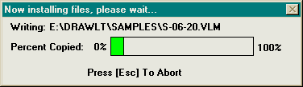
Provide feedback
Multiple files being copied,
but feedback is file by file.
Drawing Board LT

Slide 28
5. Provide feedback
Response time
  how users perceive delays
    <0.1s perceived as “instantaneous”
    1s user’s flow of thought stays uninterrupted, but delay noticed
    10s limit for keeping user’s attention focused on the dialog
    > 10s user will want to perform other tasks while waiting

Slide 29
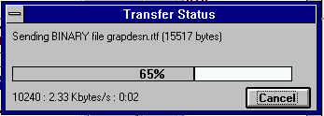
5. Provide feedback
Dealing with long delays
  Cursors
    for short transactions
  Percent done dialogs
      time left
      estimated time
  Random
    for unknown times
Contacting host (10-60 seconds)
cancel

Slide 30
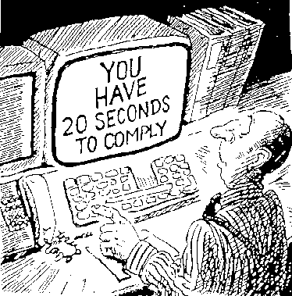
6. Provide clearly marked exits
How do I get out of this?

Slide 31

6. Provide clearly marked exits
Users don’t like to feel trapped by the computer!
  should offer an easy way out of as many situations as possible
Strategies:
  Cancel button (for dialogs waiting for user input)
  Universal Undo (can get back to previous state)
  Interrupt (especially for lengthy operations)
  Quit (for leaving the program at any time)
  Defaults (for restoring a property sheet)
Core
Dump

Slide 32
7. Provide shortcuts
Experienced users - perform frequent operations quickly
Strategies:
  keyboard and mouse accelerators
    abbreviations
    command completion
    context menus
    function keys
    double clicking vs menu selection
  type-ahead (entering input before the system is ready for it)
  navigation jumps
    e.g., going to window/location directly, and avoiding intermediate nodes
  history systems
    WWW: ~60% of pages are revisits

Slide 33
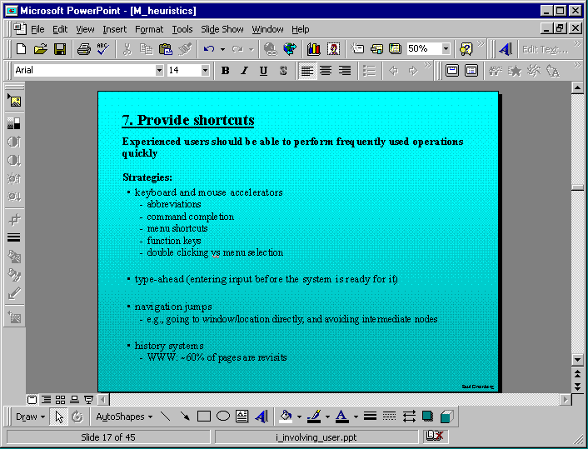
Keyboard accelerators for menus
Customizable toolbars and
palettes for frequent actions
Split menu, with recently used fonts on top
Double-click raises toolbar dialog box
Double-click raises object-specific menu
Scrolling controls for page-sized increments
Microsoft Powerpoint

Slide 34
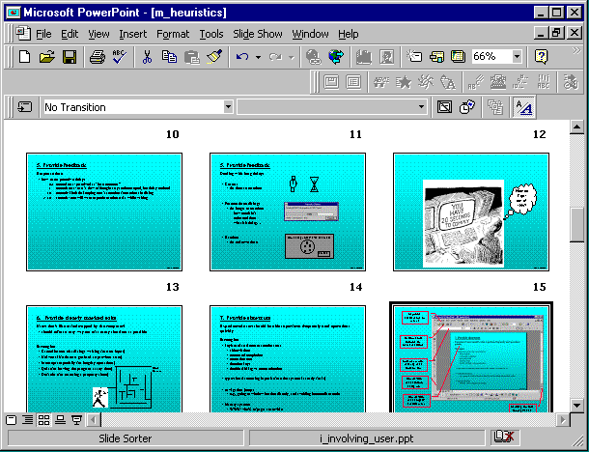
Alternate representation for quickly doing different set of tasks
Toolset brought in appropriate to this representation
Microsoft Powerpoint

Slide 35

8: Deal with errors in a positive manner
People will make errors!
Errors we make
  Mistakes
    conscious deliberations lead to an error instead of correct solution
  Slips
    unconscious behaviour gets misdirected en route to satisfying goal
      e.g. drive to store, end up in the office
    shows up frequently in skilled behaviour
      usually due to inattention
    often arises from similar actions

Slide 36
Designing for slips
General rules
  prevent slips before they occur
  detect and correct slips when they do occur
  user correction through feedback and undo

Slide 37
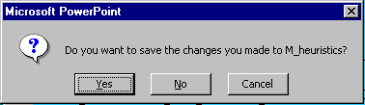
Types of slips
Capture error
  frequently done activity takes charge instead of one intended
  occurs when common & rarer actions have same initial sequence
    change clothes for dinner and find oneself in bed (William James, 1890)
    confirm saving of a file when you don’t want to delete it
  minimize by
    make actions undoable instead of confirmation
    allows reconsideration of action by user
      e.g. open trash to undelete a file
I can’t believe I pressed Yes...

Slide 38
Types of slips
Description error
  intended action similar to others that are possible
    usually occurs when right & wrong objects physically near each other
      pour juice into bowl instead of glass
      throw sweaty shirt in toilet instead of laundry basket
      move file to wrong folder with similar name
  minimize by
    rich feedback
    check for reasonable input, etc.
    undo

Slide 39
Types of slips
Loss of activation
  forget what the goal is while undergoing the sequence of actions
    start going to room and forget why you are going there
    navigating menus/dialogs & can’t remember what you are looking for
    but continue action to remember (or go back to beginning)!
  minimize by
    if system knows goal, make it explicit
    if not, allow person to see path taken

Slide 40
Types of slips
Mode errors
  people do actions in one mode thinking they are in another
    refer to file that’s in a different directory
    look for commands / menu options that are not relevant
  minimize by
    have as few modes as possible (preferably none)
    make modes highly visible

Slide 41
Generic system responses for errors
General idea: Forcing functions
  prevent / mitigate continuation of wrongful action
Gag
  deals with errors by preventing the user from continuing
    eg cannot get past login screen until correct password entered
Warn
  warn people that an unusual situation is occurring
  when overused, becomes an irritant
    e.g.,
      audible bell
      alert box

Slide 42
Generic system responses for errors
Do nothing
  illegal action just doesn’t do anything
  user must infer what happened
    enter letter into a numeric-only field (key clicks ignored)
    put a file icon on top of another file icon (returns it to original position)
Self-correct
  system guesses legal action and does it instead
  but leads to a problem of trust
    spelling corrector

Slide 43
Generic system responses for errors
Lets talk about it
  system initiates dialog with user to come up with solution to the problem
    compile error brings up offending line in source code
Teach me
  system asks user what the action was supposed to have meant
  action then becomes a legal one

Slide 44
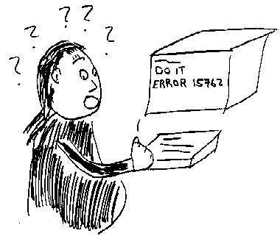
8: Deal with errors in a positive manner
What is “error 15762”?

Slide 45
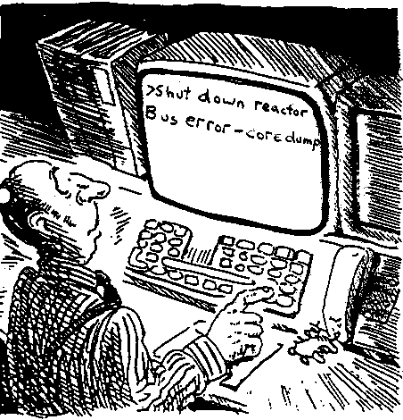
8: Deal with errors in a positive manner
A problematic message to a nuclear power plant operator

Slide 46
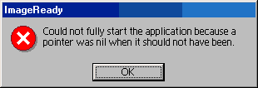
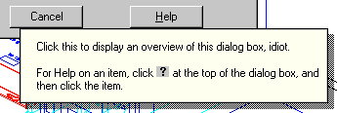
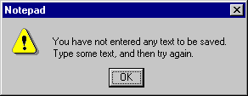
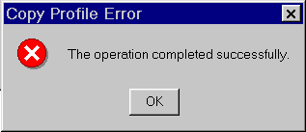
8: Deal with errors in a positive manner
Adobe's ImageReady
AutoCAD Mechanical
Windows Notepad
Microsoft's NT Operating System

Slide 47
8: Deal with errors in a positive manner
Provide meaningful error messages
  error messages should be in the user’s task language
  don’t make people feel stupid
    Try again, bonehead!
    Error 25
    Cannot open this document
    Cannot open “chapter 5” because the application “Microsoft Word”
    is not on your system
    Cannot open “chapter 5” because the application “Microsoft Word”
    is not on your system. Open it with “Teachtext” instead?

Slide 48
8: Deal with errors in a positive manner
Prevent errors
  try to make errors impossible
  modern widgets: can only enter legal data
Provide reasonableness checks on input data
  on entering order for office supplies
    5000 pencils is an unusually large order. Do you really want to order that many?

Slide 49
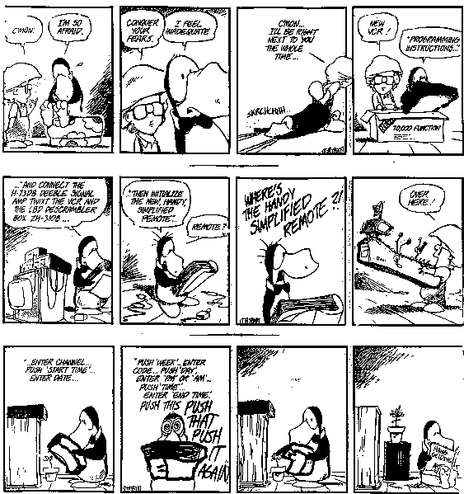
Manuals...

Slide 50


9. Provide help
Help is not a replacement for bad design!
Simple systems:
  walk up and use; minimal instructions
Most other systems
  feature rich
  simple things should be simple
  learning path for advanced features
Volume 37:
A user's
guide to...

Slide 51
Documentation and how it is used
Many users do not read manuals
  prefer to spend their time pursuing their task
Usually used when users are in some kind of panic
  paper manuals unavailable in many businesses!
    e.g. single copy locked away in system administrator’s office
  online documentation better
  good search/lookup tools
  online help specific to current context
Sometimes used for quick reference
  syntax of actions, possibilities...
  list of shortcuts ...

Slide 52
Types of help
Tutorial and/or getting started manuals
  short guides that people are likely to read when first obtaining their systems
    encourages exploration and getting to know the system
    tries to get conceptual material across and essential syntax
  on-line “tours”, exercises, and demos
    demonstrates very basic principles through working examples

Slide 53
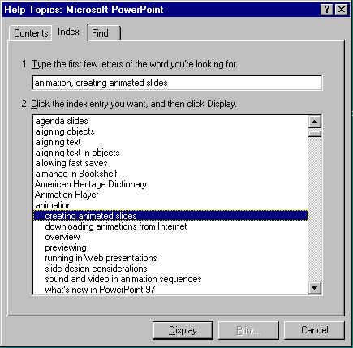
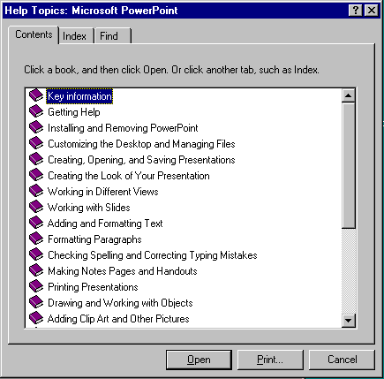
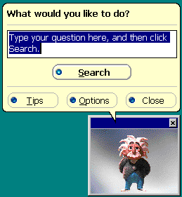
Types of help
Reference manuals
  used mostly for detailed lookup by experts
    rarely introduces concepts
    thematically arranged
  on-line hypertext
    search / find
    table of contents
    index
    cross-index
Microsoft Help

Slide 54
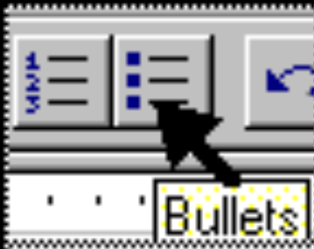
Types of help
Reminders
  short reference cards
    expert user who just wants to check facts
    novice who wants to get overview of system’s capabilities
  keyboard templates
    shortcuts/syntactic meanings of keys; recognition vs. recall; capabilities
  tooltips and other context-sensitive help
    text over graphical items indicates their meaning or purpose
Microsoft Word

Slide 55
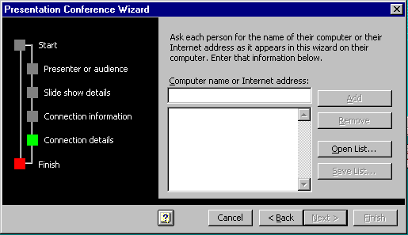
Types of help
Wizards
  walks user through typical tasks
  but dangerous if user gets stuck
What’s my computer’s name?
Fred?
Intel?
AST?
Microsoft Powerpoint

Slide 56
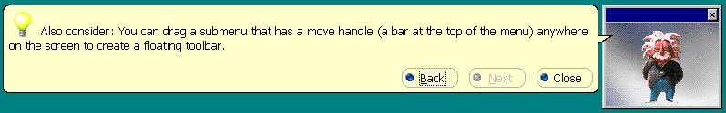
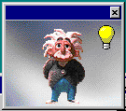
Types of help
Tips
  migration path to learning system features
  also context-specific tips on being more efficient
  must be “smart”, otherwise boring and tedious
Microsoft Word

Slide 57
Other Guidelines: Style guides
Guidelines published by producers of graphical user interfaces (GUIs)
  examples:
    Open Software Foundation MOTIF
    Open Look
    MS Windows
    Apple
Describes the “look and feel” of the GUI
  e.g. Open Look
    grouping items in the same menu:
      Use white space between long groups of controls on menus or in short groups when screen real estate is not an issue
Good, but hard too follow
  GUI and widget specific
  vast number of guidelines
  may miss fundamental design principles

Slide 58
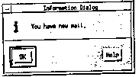
Example Motif Style Guide, Release 1.1
Message Dialogs
Description
  MessageDialogs should be used to convey a message to the user. They must not interrupt the user’s interaction with the application. They should include a message, and one of the following button arrangements.
    OK
    OK Help
    OK Cancel
    OK Cancel Help
    Yes No
    Yes No Help
    Yes No Cancel
    Yes No Cancel Help
    Cancel
    Cancel Help
    Retry Cancel
    Retry Cancel Help
Related Information
  For more information, see the reference pages for DialogBox, ErrorDialog, InformationDialog, QuestionDialog, WorkingDialog, and WarningDialog
Information Dialog
Description
  An InformationDialog should be used to convey information the the user. It must not interrupt the user’s interaction with the application. It should include an information symbol, a message, and one of the following button arrangements.
    OK
    OK Help
Illustration
Related Information
  For more information, see the reference page for DialogBox

Slide 59
Other Guidelines: Widget-level “guides”
Toolkit “hard-wires” guidelines
  repertoire of widgets
  look & feel of particular widgets
  grouping behaviour of widgets
Outside of “normal” programmer’s control
  easier to use defaults then to re-invent the wheel!
Some toolkits
  look & feel is programmer-settable or platform-dependent
Advantages:
  easy to be consistent
  widgets developed by experts (graphical designers, etc.)
Disadvantages
  can be hacked around
  interfaces “assembled” by non-interface designers can still be terrible

Slide 60
You know now
Nine principles of design
  Simple and natural dialog
  Speak the user’s language
  Minimize user’s memory load
  Be consistent
  Provide feedback
  Provide clearly marked exits
  Provide shortcuts
  Deal with errors in a positive manner
  Provide help
Heuristic evaluation
  Principles can be used to systematically inspect the interface for usability problems

Slide 61
Evaluating Heuristic evaluation
Problems found by a single inspector
Problems found by multiple inspectors
Individuals vs. teams
Self guided or scenarios?

Slide 62

Problems found by a single inspector
Average over six case studies
  35% of all usability problems;
  42% of the major problems
  32% of the minor problems
Not great, but
  finding some problems with one evaluator is
  much better than finding no problems with
  no evaluators!

Slide 63
Problems found by a single inspector
Varies according to
  difficulty of the interface being evaluated
  the expertise of the inspectors
Average problems found by:
  novice evaluators - 22%
    no usability expertise
  regular specialists - 41%
    expertise in usability
  double specialists - 60%
    experience in both usability and the particular
    kind of interface being evaluated
    also find domain-related problems
Tradeoff
  novices poorer, but cheaper!

Slide 64
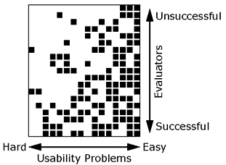
Problems found by a single inspector
Evaluators miss both easy and hard problems
  ‘best’ evaluators can miss easy problems
  ‘worse’ evaluators can discover hard problems

Slide 65

Problems found by multiple evaluators
3-5 evaluators find 66-75% of usability problems
  different people find different usability problems
  only modest overlap between the sets of problems found

Slide 66

Problems found by multiple evaluators
Where is the best cost/benefit?

Slide 67

Individuals vs teams
Nielsen
  recommends individual evaluators inspect the interface alone
Why?
  evaluation is not influenced by others
  independent and unbiased
  greater variability in the kinds of errors found
  no overhead required to organize group meetings

Slide 68
Self Guided vs Scenario Exploration
Self-guided
  open-ended exploration
  Not necessarily task-directed
  good for exploring diverse aspects of the interface, and to follow potential pitfalls
Scenarios
  step through the interface using representative end user tasks
  ensures problems identified in relevant portions of the interface
  ensures that specific features of interest are evaluated
  but limits the scope of the evaluation - problems can be missed

Slide 69
HCI
Design Rules
Heuristics and Golden Rules
Jakob Nielsen’s 10 Usability Heuristics
1. Visibility of system status: the system should always keep users informed about what is going on, through appropriate feedback within reasonable time.
2. Match between system and the real world: the system should speak the users' language, with words, phrases and concepts familiar to the user, rather than system-oriented terms. Follow real-world conventions, making information appear in a natural and logical order.
3. User control and freedom: users often choose system functions by mistake and will need a clearly marked "emergency exit" to leave the unwanted state without having to go through an extended dialogue. Support undo and redo.
4. Consistency and standards: users should not have to wonder whether different words, situations, or actions mean the same thing. Follow platform conventions.
5. Error prevention: even better than good error messages is a careful design which prevents a problem from occurring in the first place.
6. Recognition rather than recall: make objects, actions, and options visible. The user should not have to remember information from one part of the dialogue to another. Instructions for use of the system should be visible or easily retrievable whenever appropriate.
Notes:
Introduction

Slide 70
HCI
Design Rules
Heuristics and Golden Rules
Jakob Nielsen’s 10 Usability Heuristics (contd.)
7. Flexibility and efficiency of use: accelerators -- unseen by the novice user -- may often speed up the interaction for the expert user such that the system can cater to both inexperienced and experienced users. Allow users to tailor frequent actions.
8. Aesthetic and minimalist design: dialogues should not contain information which is irrelevant or rarely needed. Every extra unit of information in a dialogue competes with the relevant units of information and diminishes their relative visibility.
9. Help users recognize, diagnose, and recover from errors: error messages should be expressed in plain language (no codes), precisely indicate the problem, and constructively suggest a solution.
10. Help and documentation: even though it is better if the system can be used without documentation, it may be necessary to provide help and documentation. Any such information should be easy to search, focused on the user's task, list concrete steps to be carried out, and not be too large.
Notes:
Introduction

Slide 71
HCI
Design Rules
Heuristics and Golden Rules
Ben Shneiderman's 8 Golden Rules
1. Strive for consistency: layout, terminology, command usage, etc.
2. Cater for universal usability: recognize the requirements of diverse users and technology. For instance add features for novices eg explanations, support expert users eg shortcuts.
3. Offer informative feedback: for every user action, offer relevant feedback and information, keep the user appropriately informed, human-computer interaction.
4. Design dialogs to yield closure: help the user know when they have completed a task.
5. Offer error prevention and simple error handling: prevention and (clear and informative guidance to) recovery; error management.
6. Permit easy reversal of actions: to relieve anxiety and encourage exploration, because the user knows s/he can always go back to previous states.
7. Support internal locus of control: make the user feel that s/he is in control of the system, which reponds to his/her instructions/commands.
8. Reduce short-term memory load: make menus and UI elements/items visible, easily available/retrievable, ...
Notes:
Introduction

Slide 72
HCI
Design Rules
Heuristics and Golden Rules
[Donald] Norman's 7 Principles [study on your own]
1. Use both knowledge in the world and knowledge in the head.
2. Simplify the structure of tasks.
3. Make things visible: bridge the gulfs of Execution and Evaluation.
4. Get the mappings right.
5. Exploit the power of constraints, both natural and artificial.
6. Design for error.
7. When all else fails, standardize.
Notes:
Introduction

Slide 73


HCI Design: Nielsen’s heuristics.
1. Visible System Status
- For any activity expected to take over 3-5sec, give status feedback to user
MS Windows: search
No estimate of time
IE: download
Better feedback
- For each action, system should respond in some way; e.g. in a web form,
clicking a submit button → button changes color, or a clicking sound is made
[One way to do so is to use DHTML in forms instead of HTML]

Slide 74


HCI Design: Nielsen’s heuristics..
2. Messages must match real world, not program objects
Example:
ATM machine message when trying to withdraw some money:
Poor:
User does not care what is X.25
What is the ‘Local limit’ ?
Better:
Tells user what they can do;
Blocks out restricted actions

Slide 75

HCI Design: Nielsen’s heuristics…
3. User control and freedom
- For choice made by error, provide a ‘way back’ [e.g. undo, redo], or
a method to re-start [e.g. Home button on website]
undo, redo
link to home
where you are

Slide 76



HCI Design: Nielsen’s heuristics….
4. Use Consistent (or better, Standard) terminology and icons
- Do not use multiple words/names for same function in different places
- Consistent terminology in prompts, menus, and user-guides
- Use icons/images without ambiguous meanings
- Consistent color, layout, capitalization, and fonts throughout the application
MS Internet explorer:
Search in page, or Print Preview?
US road signs:
Which one is for “curvy road ahead?

Slide 77

HCI Design: Nielsen’s heuristics…..
5. Eliminate potential errors
Avoid possibility for user to make errors
No calendar !

Slide 78

HCI Design: Nielsen’s heuristics……
6. Recognition is better than recall
- show the choices made by user at an earlier stage, instead of having
to remember earlier actions
Example: NikeID
Previous choices
What remains?

Slide 79

HCI Design: Nielsen’s heuristics…….
7. Flexibility and efficient use
For novice users, provide easy (though longer) interactions),
For advanced/frequent users, provide: short-cut, special keys, macros, …
Example: Special keys
Example: shortcut
ALT+e
ALT+e+t

Slide 80




HCI Design: Nielsen’s heuristics……..
8. Help the user to recognize, diagnose, and recover from error
Error messages should be expressed in plain language (no codes),
precisely indicate the problem, and constructively suggest a solution.
Poor design examples:

Slide 81

HCI Design: Nielsen’s heuristics………
9. Help and Documentation
- Must provide help/manual/user-guide
- Language and format of User-guide should use simple, standard terminology
MS Help: (Good design)
- standardized format; provides search; book-metaphor; use of links

Slide 82
HCI Design: Nielsen’s heuristics
10. Aesthetics and minimalist design
- Do not put too much, irrelevant information in Dialog boxes
- Use standard and commonly accepted controls (sliders, buttons etc.)
- Select fonts/sizes that are suited for screen display to maximize readability
Fonts designed for web use (readable on-screen in large/small font size):
This is an example of Verdana and smaller
This is an example of Georgia
Others: Arial, Comic Sans MS, Adobe Minion web (Internet Explorer default)
How to ensure your font is used on client? Cascading Style Sheets (XML)

Slide 83

Gerhardt-Powals Heuristics.
1. Automate unwanted workload
- Eliminate mental calculations, estimations, and unnecessary thinking
Example:
Travel agent website:
Destination selection: Selection list
Departure date:
- allows proper dates only;
- linked to a calendar tool
[image source: www.cxholidays.com]
Notes:
Gerhardt-Powals proposed a set of ten guidelines, or heuristics. Some are similar to Nielsen’s and therefore omitted here.

Slide 84


Gerhardt-Powals Heuristics..
2. Reduce uncertainty by clear and obvious display of data
Poor design:
Better design:

Slide 85

Gerhardt-Powals Heuristics…
3. Reduce cognitive load by combining lower-level data into
a higher-level summation
4. Group data in consistently meaningful ways to
decrease search time
Example: setting options in Powerpoint™

Slide 86


Gerhardt-Powals Heuristics….
5. Use names that are conceptually related to function
- Terminology should be easy to recall/recognize
- Terminology should be context dependent
Example: Tool (or functions) provided by Adobe Photoshop

Slide 87




Gerhardt-Powals Heuristics…..
6. Present data in a way to ease processing time
- do not require user to perform combinations, addition, subtraction etc.
- use colors*/graphical outputs for easy visualization
*Special caution: design to accommodate color-blind users
Colors of rainbow
Don’t use only color to present choices
Use combination of Color, Images (icons), Words
How the colors of rainbow appear to people
with different types of color-blindness

Slide 88

Gerhardt-Powals Heuristics……
7. Include only the information a user needs at a given time
- Do not distract user with non-essential data
Bad design !!

Slide 89
Summary
What you have learnt:
- Success/Failure of IT systems may depend on User-Interface they provide
- Principles of good user-interface design
- How to identify poor interface design
- How to to improve poor designs by application of Nielsen or
Gerhardt-Powals heuristics
Useful technologies in design of good GUI’s:
Active: programming languages like VB, VC++, Javascript
Passive: HTML, XML, DHTML, Cascading Style Sheets, …

Slide 90
References and Further Reading
This book is available online via the library:
Jeff Johnson, Web bloopers: 60 common web design mistakes, Academic Press
Web sources:
1. Bruce Tognazzini’s Principles of interactive design
2. NASA Usability web-site (great resource!)
3. Bonnie Skaalid’s guidelines
4. Discussion of Nielsen and Gerhardt-Powals heuristics in HFI
Next: Common tools used in applications – sort, search

